Slide 1
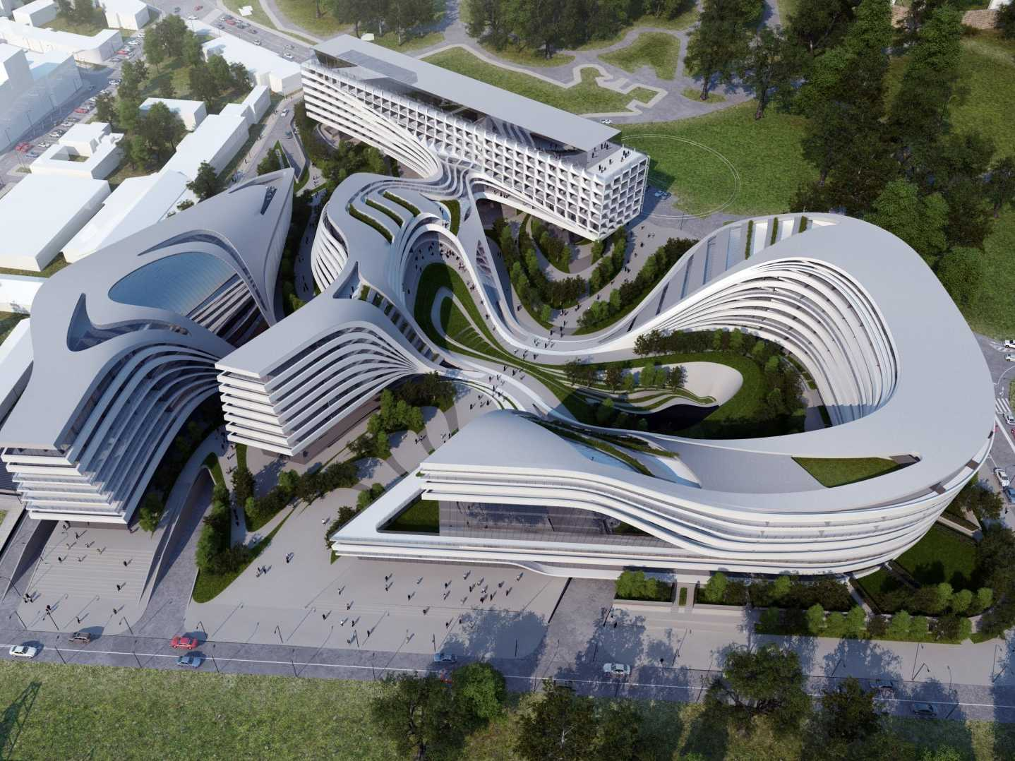
Data Virtualization
PDTool Training
Multi-Tenant Configuration
Presenter
Title

Slide 2
Agenda
PDTool VCS Multi-Tenant

Slide 3
Version Control for Multi-Tenants
A multi-tenant environment contains multiple groups or organizations sharing the Data Virtualization infrastructure.
© Copyright 2000-2017 TIBCO Software Inc.
Notes:
Next, let’s examine some common deployment options for DV.

Slide 4
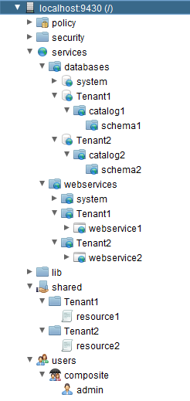



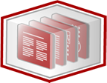
Multi-Tenant VCS Topology
Multi-Tenant VCS Topology
DV Studio Resource Definition
Read
Write
DV Studio (Tenant1)
DV Studio Resource Definition
Read
Write
Check In
DV Repository
DV Studio (Tenant 2)
Check Out
VCS Repository
DV Studio Resource Definition
Read
Write
DV Studio (Tenant 3)
© Copyright 2000-2017 TIBCO Software Inc.

Slide 5
Version Control with Multi-Tenants
Requirement
Need to configure VCS integration for a single tenant and not the entire DV repository.
How PDTool works with Version Control
VCS integration is configured at the DV Server level.
All DV base folders must get checked in.
Invalid results will occur if intermediate folders are not checked in.
The initial check-in must be done at DV root folder “/” of the DV repository.
This insures that all required folders get checked in.
© Copyright 2000-2017 TIBCO Software Inc.

Slide 6
Multi-Tenant VCS Strategy – Automated
Strategy – Automated
PDTool – use “vcsInitializeBaseFolderCheckin” in a deployment plan
1
Prepare VCS Repository (admin)
Install
PD Tool
2
Configure VCS Specific Environment Properties
3
4.2
Initialize VCS Base Folders (admin)
4.1
Initialize VCS Workspace
© Copyright 2000-2017 TIBCO Software Inc.

Slide 7
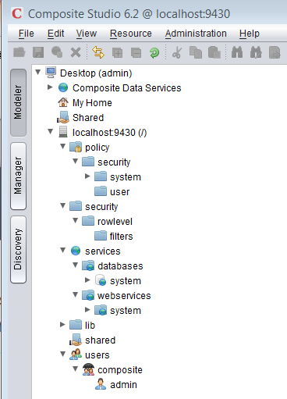
Data Virtualization Base-Level Folders
Base level folders (/)
/policy
/security
/user
/security
/rowlevel
/filters
/services
/databases
/services
/webservices
/shared
/system
/connector
/users
/composite
/admin
root.cmf
policy.cmf
security.cmf
user.cmf
security.cmf
rowlevel.cmf
filters.cmf
services.cmf
databases.cmf
services.cmf
webservices.cmf
shared.cmf
system.cmf
connector.cmf
users.cmf
composite.cmf
admin.cmf
© Copyright 2000-2017 TIBCO Software Inc.

Slide 8
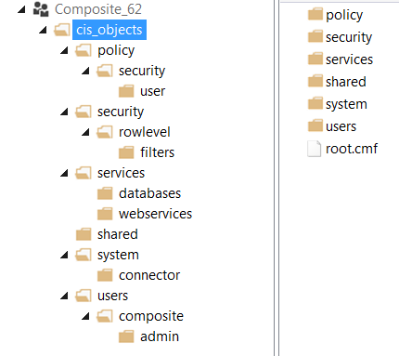
Admin Check-in Data Virtualization Base-Level Folders
Studio VCS: Check-in to VCS
Attach folders to VCS
Base level folders (/)
/policy
/security
/user
/security
/rowlevel
/filters
/services
/databases
/services
/webservices
/shared
/system
/connector
/users
/composite
/admin
VCS: Checked in base-level structure
© Copyright 2000-2017 TIBCO Software Inc.

Slide 9
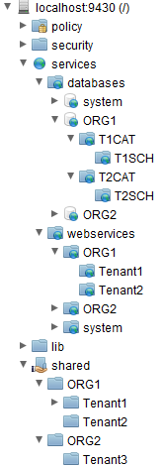
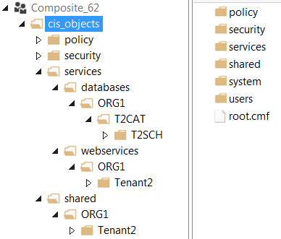
Admin Check-in Data Virtualization Custom Folders
Studio: Check-in to VCS
Custom DV folders
VCS: Checked in custom folder structure
Database
Web Service
Shared
© Copyright 2000-2017 TIBCO Software Inc.

Slide 10
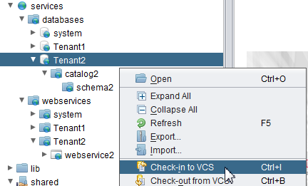
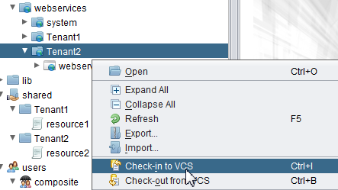
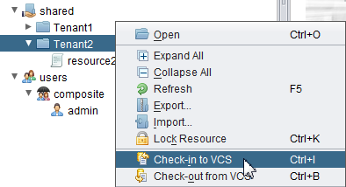
Multi-Tenant User2 Check-in from Studio
DV Studio Resources
Check-in Tenant2 only
© Copyright 2000-2017 TIBCO Software Inc.

Slide 11
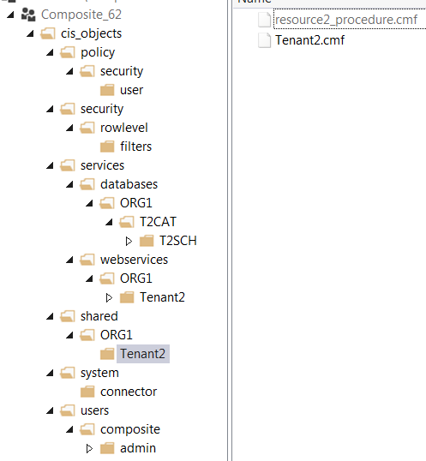
Multi-Tenant User2 Check-in Results
DV Studio Resources
VCS Server: Results of Check-in
Studio resource2 is checked in as resource2_procedure.cmf
Folders are checked in as the foldername.cmf e.g. Tenant2.cmf
Tenant1 objects have not been checked in.
Tenant2 can manage their objects independent of Tenant 1
© Copyright 2000-2017 TIBCO Software Inc.

Slide 12
Q&A
© Copyright 2000-2017 TIBCO Software Inc.
Notes:
Next, let’s examine some common deployment options for DV.

